Slide 1








Hey there!
Our team
Rudaina A. Mitman
Ali Alansari
Saif Alneyadi
Ruthvik Vijayakumar
Sanjay Devang
MBA/MS Information Systems Technology
MS Information Systems Technology, Entrepreneurship
MS Information Systems Technology
MS Information Systems Technology
MS Information Systems Technology
Area of expertise:
Consulting, Finance, FinTech, Media, International Org.
Area of expertise:
Technology, Entrepreneurship, SMEs
Area of expertise:
Technology, Computer Engineering
Area of expertise:
Technology, AdTech
Area of expertise:
Technology, Cloud Solution Architecture

Slide 2
Hey there!
Our team
Rudaina A. Mitman
Ali Alansari
Saif Alneyadi
Ruthvik Vijayakumar
Sanjay Devang
MBA/MS Information Systems Technology
MS Information Systems Technology, Entrepreneurship
MS Information Systems Technology
MS Information Systems Technology
MS Information Systems Technology
Area of expertise:
Consulting, Finance, FinTech, Media, International Org.
Area of expertise:
Technology, Entrepreneurship, SMEs
Area of expertise:
Technology, Computer Engineering
Area of expertise:
Technology, AdTech
Area of expertise:
Technology, Cloud Solution Architecture
Agenda
Company
overview
+ Introduction
+ Business model
+ User demographics
Analyses
+ Methodology of
conducting analyses
+ Data source
+ Market analysis
+ Financial analysis
+ Metrics from annual
financial analysis
Key Performance
Indicators (KPIs)

Slide 3
Our team
Rudaina A. Mitman
Ali Alansari
Saif Alneyadi
Ruthvik Vijayakumar
Sanjay Devang
MBA/MS Information Systems Technology
MS Information Systems Technology, Entrepreneurship
MS Information Systems Technology
MS Information Systems Technology
MS Information Systems Technology
Area of expertise:
Consulting, Finance, FinTech, Media, International Org.
Area of expertise:
Technology, Entrepreneurship, SMEs
Area of expertise:
Technology, Computer Engineering
Area of expertise:
Technology, AdTech
Area of expertise:
Technology, Cloud Solution Architecture
Agenda
Company
overview
+ Introduction
+ Business model
+ User demographics
Analyses
+ Methodology of
conducting analyses
+ Data source
+ Market analysis
+ Financial analysis
+ Metrics from annual
financial analysis
Key Performance
Indicators (KPIs)

Slide 4
Our team
Rudaina A. Mitman
Ali Alansari
Saif Alneyadi
Ruthvik Vijayakumar
Sanjay Devang
MBA/MS Information Systems Technology
MS Information Systems Technology
MS Information Systems Technology
MS Information Systems Technology
MS Information Systems Technology
Industry of expertise:
Consulting, Finance, FinTech, Media, International Org.
Industry of expertise:
Consulting, Finance, FinTech, Media, International Org.
Industry of expertise:
Consulting, Finance, FinTech, Media, International Org.
Industry of expertise:
Consulting, Finance, FinTech, Media, International Org.
Industry of expertise:
Consulting, Finance, FinTech, Media, International Org.
Agenda
Company
overview
+ Introduction
+ Business model
+ User demographics
Analyses
+ Methodology of
conducting analyses
+ Data source
+ Market analysis
+ Financial analysis
+ Metrics from annual
financial analysis
Key Performance
Indicators (KPIs)

Slide 5
Agenda
Company
overview
+ Introduction
+ Business model
+ User demographics
Analyses
+ Methodology of
conducting analyses
+ Data source
+ Market analysis
+ Financial analysis
+ Metrics from annual
financial analysis
Key Performance
Indicators (KPIs)
Key Performance
Indicators (KPIs)

Slide 6
Agenda
Company
overview
+ Introduction
+ Business model
+ User demographics
Analyses
+ Methodology of
conducting analyses
+ Data source
+ Market analysis
+ Financial analysis
+ Metrics from annual
financial analysis
Key Performance
Indicators (KPIs)
Key Performance
Indicators (KPIs)
Recommendations

Slide 7
Agenda
Company
overview
+ Introduction
+ Business model
+ User demographics
Analyses
+ Methodology of
conducting analyses
+ Data source
+ Market analysis
+ Financial analysis
+ Metrics from annual
financial analysis
Key Performance
Indicators (KPIs)
Recommendations

Slide 8

Agenda
Company
overview
+ Introduction
+ Business model
+ User demographics
Analyses
+ Methodology of
conducting analyses
+ Data source
+ Market analysis
+ Financial analysis
+ Metrics from annual
financial analysis
Key Performance
Indicators (KPIs)
Recommendations
Company Overview

Slide 9
Agenda
Company
overview
+ Introduction
+ Business model
+ User demographics
Analyses
+ Methodology of
conducting analyses
+ Data source
+ Market analysis
+ Financial analysis
+ Metrics from annual
financial analysis
Key Performance
Indicators (KPIs)
Recommendations
Company Overview

Slide 10
Company Overview
IND.
EST.
HQ
2024
Music Streaming
Podcasting
Audio Entertainment
2006
by Daniel Ek and Martin Lorentzon
Stockholm, Sweden
640m monthly active users
180+ markets worldwide
100m+
tracks
6m+
Podcast titles

Slide 11
Company Overview
IND.
EST.
HQ
2024
Music Streaming
Podcasting
Audio Entertainment
2006
by Daniel Ek and Martin Lorentzon
Stockholm, Sweden
640m monthly active users
180+ markets worldwide
100m+
tracks
6m+
Podcast titles

Slide 12
Company Overview
IND.
EST.
HQ
2024
Music Streaming
Podcasting
Audio Entertainment
2006
by Daniel Ek and Martin Lorentzon
Stockholm, Sweden
640m monthly active users
180+ markets worldwide
100m+
tracks
6m+
Podcast titles

Slide 13
Company Overview
IND.
EST.
HQ
2024
Music Streaming
Podcasting
Audio Entertainment
2006
by Daniel Ek and Martin Lorentzon
Stockholm, Sweden
640m monthly active users
180+ markets worldwide
100m+
tracks
6m+
Podcast titles

Slide 14
Company Overview
IND.
EST.
HQ
2024
Music Streaming
Podcasting
Audio Entertainment
2006
by Daniel Ek and Martin Lorentzon
Stockholm, Sweden
640m monthly active users
180+ markets worldwide
100m+
tracks
6m+
Podcast titles

Slide 15
Company Overview
IND.
EST.
HQ
2024
Music Streaming
Podcasting
Audio Entertainment
2006
by Daniel Ek and Martin Lorentzon
Stockholm, Sweden
640m monthly active users
180+ markets worldwide
100m+
tracks
6m+
Podcast titles

Slide 16
Company Overview
IND.
EST.
HQ
2024
Music Streaming
Podcasting
Audio Entertainment
2006
by Daniel Ek and Martin Lorentzon
Stockholm, Sweden
640m monthly active users
180+ markets worldwide
100m+
tracks
6m+
Podcast titles

Slide 17
Company Overview
IND.
EST.
HQ
2024
Music Streaming
Podcasting
Audio Entertainment
2006
by Daniel Ek and Martin Lorentzon
Stockholm, Sweden
640m monthly active users
180+ markets worldwide
100m+
tracks
6m+
Podcast titles

Slide 18
Company Overview
2024
IND.
EST.
HQ
640m monthly active users
180+ markets worldwide
100m+
tracks
6m+
Podcast titles
Music Streaming
Podcasting
Audio Entertainment
2006
by Daniel Ek and Martin Lorentzon
Stockholm, Sweden

Slide 19
Company Overview
2024
640m monthly active users
180+ markets worldwide
100m+
tracks
6m+
Podcast titles
IND.
EST.
HQ
Music Streaming
Podcasting
Audio Entertainment
2006
by Daniel Ek and Martin Lorentzon
Stockholm, Sweden

Slide 20
Company Overview
2024
640m monthly active users
180+ markets worldwide
100m+
tracks
6m+
Podcast titles
IND.
EST.
HQ
Music Streaming
Podcasting
Audio Entertainment
2006
by Daniel Ek and Martin Lorentzon
Stockholm, Sweden

Slide 21



Company Overview
2024
640m monthly active users
180+ markets worldwide
100m+
tracks
6m+
Podcast titles
IND.
EST.
HQ
Music Streaming
Podcasting
Audio Entertainment
2006
by Daniel Ek and Martin Lorentzon
Stockholm, Sweden
Business Model
Freemium
business model
Entry-level access
provided in the free tier, supported by advertisements
Premium tier
offers ad-free listening, offline playback, and higher audio quality

Slide 22




Company Overview
2024
640m monthly active users
180+ markets worldwide
100m+
tracks
6m+
Podcast titles
IND.
EST.
HQ
Music Streaming
Podcasting
Audio Entertainment
2006
by Daniel Ek and Martin Lorentzon
Stockholm, Sweden
Business Model
Freemium
business model
Entry-level access
provided in the free tier, supported by advertisements
Premium tier
offers ad-free listening, offline playback, and higher audio quality
Subscription plans for Individuals, Students, and Families
640 million
active users, from which
252 million
are paying subscribers
Royalty payments
for creators based on the number of streams
Spotify for Artists
offers promotional tools like data analytics

Slide 23
Business Model
Freemium
business model
Entry-level access
provided in the free tier, supported by advertisements
Premium tier
offers ad-free listening, offline playback, and higher audio quality
Subscription plans for Individuals, Students, and Families
640 million
active users, from which
252 million
are paying subscribers
Royalty payments
for creators based on the number of streams
Spotify for Artists
offers promotional tools like data analytics

Slide 24
Business Model
Freemium
business model
Entry-level access
provided in the free tier, supported by advertisements
Premium tier
offers ad-free listening, offline playback, and higher audio quality
Subscription plans for Individuals, Students, and Families
640 million
active users, from which
252 million
are paying subscribers
Royalty payments
for creators based on the number of streams
Spotify for Artists
offers promotional tools like data analytics

Slide 25
Company Overview
2024
640m monthly active users
180+ markets worldwide
100m+
tracks
6m+
Podcast titles
IND.
EST.
HQ
Music Streaming
Podcasting
Audio Entertainment
2006
by Daniel Ek and Martin Lorentzon
Stockholm, Sweden
Business Model
Freemium
business model
Entry-level access
provided in the free tier, supported by advertisements
Premium tier
offers ad-free listening, offline playback, and higher audio quality
Subscription plans for Individuals, Students, and Families
640 million
active users, from which
252 million
are paying subscribers
Royalty payments
for creators based on the number of streams
Spotify for Artists
offers promotional tools like data analytics

Slide 26
Company Overview
2024
640m monthly active users
180+ markets worldwide
100m+
tracks
6m+
Podcast titles
IND.
EST.
HQ
Music Streaming
Podcasting
Audio Entertainment
2006
by Daniel Ek and Martin Lorentzon
Stockholm, Sweden
Business Model
Freemium
business model
Entry-level access
provided in the free tier, supported by advertisements
Premium tier
offers ad-free listening, offline playback, and higher audio quality
Subscription plans for Individuals, Students, and Families
640 million
active users, from which
252 million
are paying subscribers
Royalty payments
for creators based on the number of streams
Spotify for Artists
offers promotional tools like data analytics

Slide 27
Company Overview
2024
640m monthly active users
180+ markets worldwide
100m+
tracks
6m+
Podcast titles
IND.
EST.
HQ
Music Streaming
Podcasting
Audio Entertainment
2006
by Daniel Ek and Martin Lorentzon
Stockholm, Sweden
Business Model
Freemium
business model
Entry-level access
provided in the free tier, supported by advertisements
Premium tier
offers ad-free listening, offline playback, and higher audio quality
Subscription plans for Individuals, Students, and Families
640 million
active users, from which
252 million
are paying subscribers
Royalty payments
for creators based on the number of streams
Spotify for Artists
offers promotional tools like data analytics

Slide 28
Company Overview
2024
640m monthly active users
180+ markets worldwide
100m+
tracks
6m+
Podcast titles
IND.
EST.
HQ
Music Streaming
Podcasting
Audio Entertainment
2006
by Daniel Ek and Martin Lorentzon
Stockholm, Sweden
Business Model
Freemium
business model
Entry-level access
provided in the free tier, supported by advertisements
Premium tier
offers ad-free listening, offline playback, and higher audio quality
Subscription plans for Individuals, Students, and Families
640 million
active users, from which
252 million
are paying subscribers
Royalty payments
for creators based on the number of streams
Spotify for Artists
offers promotional tools like data analytics

Slide 29
Company Overview
2024
640m monthly active users
180+ markets worldwide
100m+
tracks
6m+
Podcast titles
IND.
EST.
HQ
Music Streaming
Podcasting
Audio Entertainment
2006
by Daniel Ek and Martin Lorentzon
Stockholm, Sweden
Business Model
Freemium
business model
Entry-level access
provided in the free tier, supported by advertisements
Premium tier
offers ad-free listening, offline playback, and higher audio quality
Subscription plans for Individuals, Students, and Families
640 million
active users, from which
252 million
are paying subscribers
Royalty payments
for creators based on the number of streams
Spotify for Artists
offers promotional tools like data analytics

Slide 30
Company Overview
2024
640m monthly active users
180+ markets worldwide
100m+
tracks
6m+
Podcast titles
IND.
EST.
HQ
Music Streaming
Podcasting
Audio Entertainment
2006
by Daniel Ek and Martin Lorentzon
Stockholm, Sweden
Business Model
Freemium
business model
Entry-level access
provided in the free tier, supported by advertisements
Premium tier
offers ad-free listening, offline playback, and higher audio quality
Subscription plans for Individuals, Students, and Families
640 million
active users, from which
252 million
are paying subscribers
Royalty payments
for creators based on the number of streams
Spotify for Artists
offers promotional tools like data analytics

Slide 31
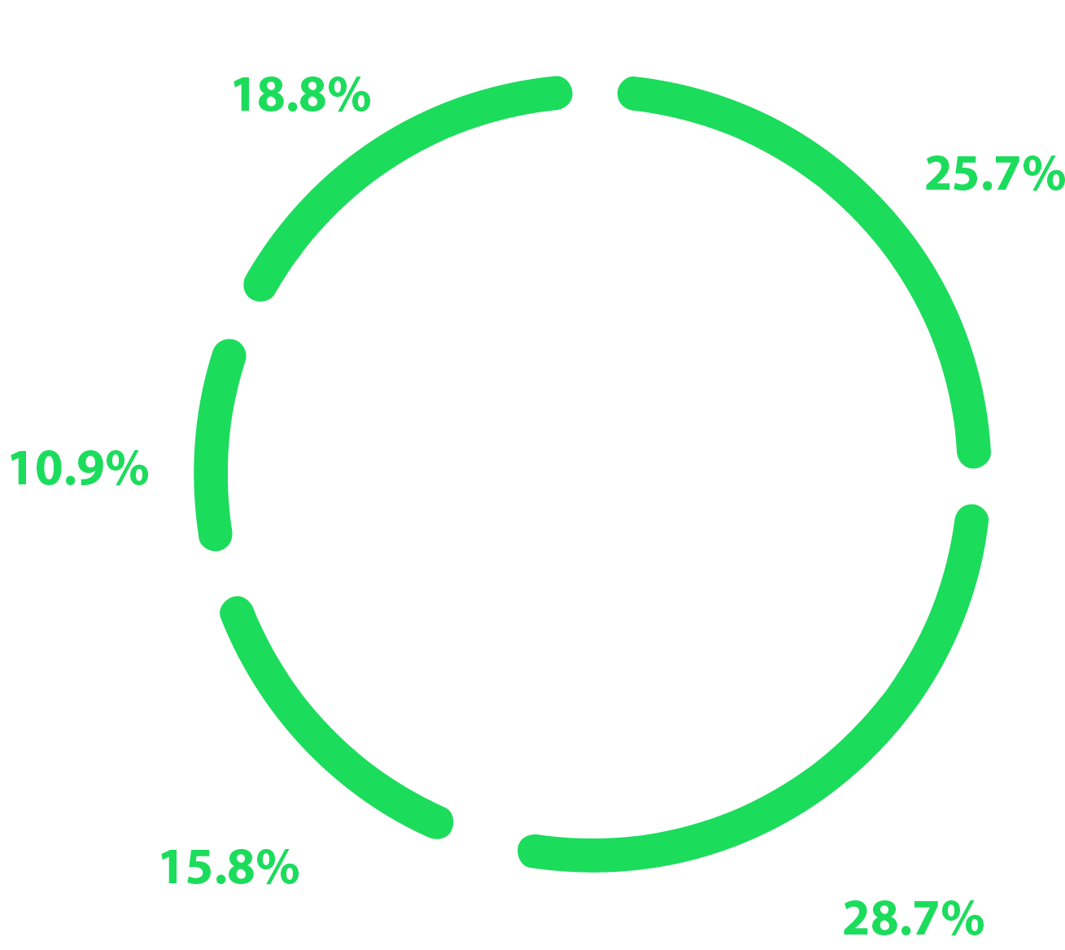
Business Model
Freemium
business model
Entry-level access
provided in the free tier, supported by advertisements
Premium tier
offers ad-free listening, offline playback, and higher audio quality
Subscription plans for Individuals, Students, and Families
640 million
active users, from which
252 million
are paying subscribers
Royalty payments
for creators based on the number of streams
Spotify for Artists
offers promotional tools like data analytics
User Demographics
Spotify Age Demographics (%)

Slide 32
Business Model
Freemium
business model
Entry-level access
provided in the free tier, supported by advertisements
Premium tier
offers ad-free listening, offline playback, and higher audio quality
Subscription plans for Individuals, Students, and Families
640 million
active users, from which
252 million
are paying subscribers
Royalty payments
for creators based on the number of streams
Spotify for Artists
offers promotional tools like data analytics
User Demographics
Spotify Age Demographics (%)

Slide 33
User Demographics
Spotify Age Demographics (%)
50%+ dominated by young adults aged 18-34

Slide 34
User Demographics
13-17 engage with the free, ad-supported tier
Spotify Age Demographics (%)
50%+ dominated by young adults aged 18-34

Slide 35
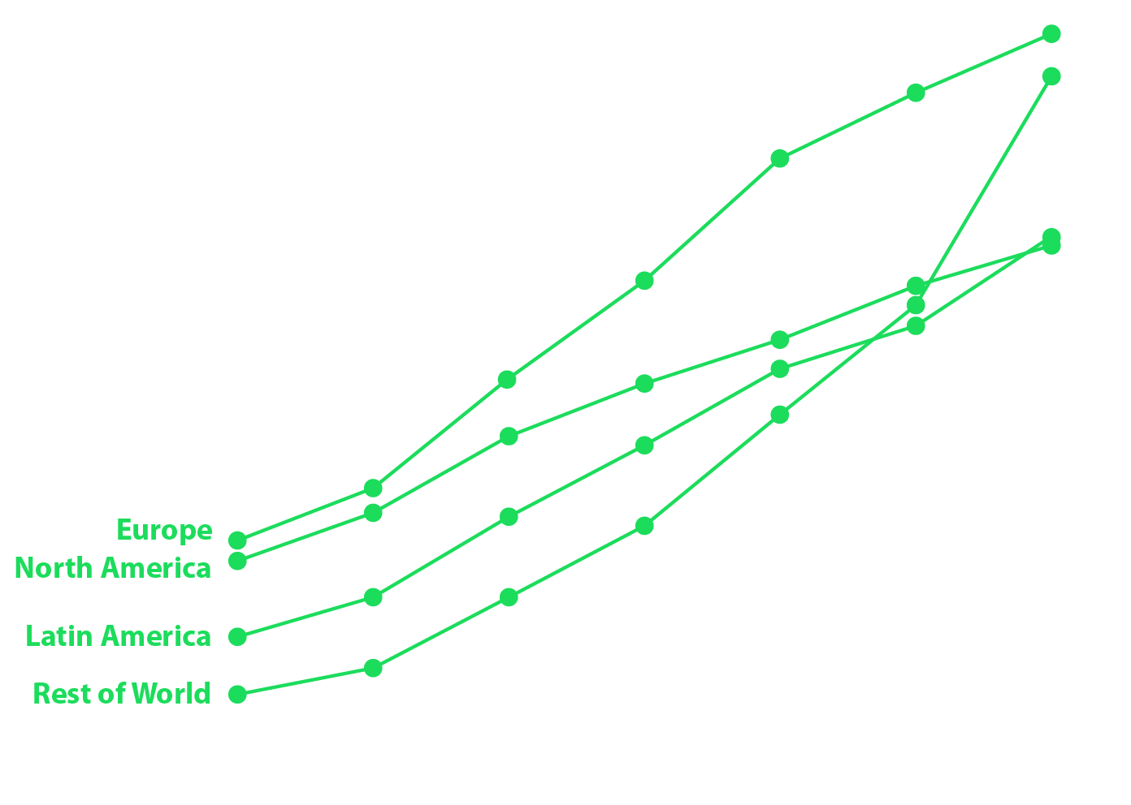
User Demographics
Spotify Age Demographics (%)
Spotify Annual Users (mm)
13-17 engage with the free, ad-supported tier
50%+ dominated by young adults aged 18-34
35-55+ are attracted to podcasts

Slide 36
User Demographics
Spotify Age Demographics (%)
Spotify Annual Users (mm)
13-17 engage with the free, ad-supported tier
50%+ dominated by young adults aged 18-34
35-55+ are attracted to podcasts

Slide 37
User Demographics
Spotify Age Demographics (%)
Spotify Annual Users (mm)
13-17 engage with the free, ad-supported tier
Europe and North America remain key markets
+50% dominated by young adults aged 18-34
35-55+ are attracted to podcasts

Slide 38
User Demographics
Spotify Age Demographics (%)
Spotify Annual Users (mm)
Strong growth in Latin America and other regions
13-17 engage with the free, ad-supported tier
Europe and North America remain key markets
+50% dominated by young adults aged 18-34
35-55+ are attracted to podcasts

Slide 39






User Demographics
Spotify Age Demographics (%)
Spotify Annual Users (mm)
Methodology of conducting analyses
Data Collection
E.g. engagement metrics, subscription trends, and financial statistics
Competitive Analysis & Benchmarking
Analyzed market Share, UX, monetization strategies, engagement levels
Recommendation Development
Actionable strategies to upsell plans and enhance monetization strategies

Slide 40
User Demographics
Spotify Age Demographics (%)
Spotify Annual Users (mm)
Methodology of conducting analyses
Data Collection
E.g. engagement metrics, subscription trends, and financial statistics
Competitive Analysis & Benchmarking
Analyzed market Share, UX, monetization strategies, engagement levels
Recommendation Development
Actionable strategies to upsell plans and enhance monetization strategies

Slide 41
Methodology of conducting analyses
Data Collection
E.g. engagement metrics, subscription trends, and financial statistics
Competitive Analysis & Benchmarking
Analyzed market Share, UX, monetization strategies, engagement levels
Recommendation Development
Actionable strategies to upsell plans and enhance monetization strategies

Slide 42
Methodology of conducting analyses
Data Collection
E.g. engagement metrics, subscription trends, and financial statistics
Competitive Analysis & Benchmarking
Analyzed market Share, UX, monetization strategies, engagement levels
Recommendation Development
Actionable strategies to upsell plans and enhance monetization strategies

Slide 43
Methodology of conducting analyses
Data Collection
E.g. engagement metrics, subscription trends, and financial statistics
Competitive Analysis & Benchmarking
Analyzed market Share, UX, monetization strategies, engagement levels
Recommendation Development
Actionable strategies to upsell plans and enhance monetization strategies

Slide 44
Methodology of conducting analyses
Data Collection
E.g. engagement metrics, subscription trends, and financial statistics
Competitive Analysis & Benchmarking
Analyzed market Share, UX, monetization strategies, engagement levels
Recommendation Development
Actionable strategies to upsell plans and enhance monetization strategies

Slide 45


Methodology of conducting analyses
Data Collection
E.g. engagement metrics, subscription trends, and financial statistics
Competitive Analysis & Benchmarking
Analyzed market Share, UX, monetization strategies, engagement levels
Recommendation Development
Actionable strategies to upsell plans and enhance monetization strategies

Slide 46
Methodology of conducting analyses
Data Collection
E.g. engagement metrics, subscription trends, and financial statistics
Competitive Analysis & Benchmarking
Analyzed market Share, UX, monetization strategies, engagement levels
Recommendation Development
Actionable strategies to upsell plans and enhance monetization strategies

Slide 47
Methodology of conducting analyses
Data Collection
E.g. engagement metrics, subscription trends, and financial statistics
Competitive Analysis & Benchmarking
Analyzed market Share, UX, monetization strategies, engagement levels
Recommendation Development
Actionable strategies to upsell plans and enhance monetization strategies

Slide 48
Methodology of conducting analyses
Data Collection
E.g. engagement metrics, subscription trends, and financial statistics
Competitive Analysis & Benchmarking
Analyzed market Share, UX, monetization strategies, engagement levels
Recommendation Development
Actionable strategies to upsell plans and enhance monetization strategies

Slide 49
Methodology of conducting analyses
Data Collection
E.g. engagement metrics, subscription trends, and financial statistics
Competitive Analysis & Benchmarking
Analyzed market Share, UX, monetization strategies, engagement levels
Recommendation Development
Actionable strategies to upsell plans and enhance monetization strategies

Slide 50


Methodology of conducting analyses
Data Collection
E.g. engagement metrics, subscription trends, and financial statistics
Competitive Analysis & Benchmarking
Analyzed market Share, UX, monetization strategies, engagement levels
Recommendation Development
Actionable strategies to upsell plans and enhance monetization strategies
Data Sources
Third-Party Data Sources
Statista(Users, Revenue and Market Data), SEMrush, Google Trends, AnswerThePublic (SEO Insights, Market trends, Competitive Analysis) & Kaggle (User behavior data)
Spotify Quarterly Shareholder Reports & Annual Financial Statements
Key metrics such as Monthly Active Users (MAUs), Premium Subscriber Growth, revenue breakdown, and operating expenses will be analyzed to understand current performance and areas for improvement.

Slide 51
Methodology of conducting analyses
Data Collection
E.g. engagement metrics, subscription trends, and financial statistics
Competitive Analysis & Benchmarking
Analyzed market Share, UX, monetization strategies, engagement levels
Recommendation Development
Actionable strategies to upsell plans and enhance monetization strategies
Data Sources
Third-Party Data Sources
Statista(Users, Revenue and Market Data), SEMrush, Google Trends, AnswerThePublic (SEO Insights, Market trends, Competitive Analysis) & Kaggle (User behavior data)
Spotify Quarterly Shareholder Reports & Annual Financial Statements
Key metrics such as Monthly Active Users (MAUs), Premium Subscriber Growth, revenue breakdown, and operating expenses will be analyzed to understand current performance and areas for improvement.

Slide 52
Data Sources
Third-Party Data Sources
Statista(Users, Revenue and Market Data), SEMrush, Google Trends, AnswerThePublic (SEO Insights, Market trends, Competitive Analysis) & Kaggle (User behavior data)
Spotify Quarterly Shareholder Reports & Annual Financial Statements
Key metrics such as Monthly Active Users (MAUs), Premium Subscriber Growth, revenue breakdown, and operating expenses will be analyzed to understand current performance and areas for improvement.

Slide 53
Data Sources
Third-Party Data Sources
Statista(Users, Revenue and Market Data), SEMrush, Google Trends, AnswerThePublic (SEO Insights, Market trends, Competitive Analysis) & Kaggle (User behavior data)
Spotify Quarterly Shareholder Reports & Annual Financial Statements
Key metrics such as Monthly Active Users (MAUs), Premium Subscriber Growth, revenue breakdown, and operating expenses will be analyzed to understand current performance and areas for improvement.

Slide 54
Data Sources
Third-Party Data Sources
Statista(Users, Revenue and Market Data), SEMrush, Google Trends, AnswerThePublic (SEO Insights, Market trends, Competitive Analysis) & Kaggle (User behavior data)
Spotify Quarterly Shareholder Reports & Annual Financial Statements
Key metrics such as Monthly Active Users (MAUs), Premium Subscriber Growth, revenue breakdown, and operating expenses will be analyzed to understand current performance and areas for improvement.

Slide 55
Data Sources
Third-Party Data Sources
Statista(Users, Revenue and Market Data), SEMrush, Google Trends, AnswerThePublic (SEO Insights, Market trends, Competitive Analysis) & Kaggle (User behavior data)
Spotify Quarterly Shareholder Reports & Annual Financial Statements
Key metrics such as Monthly Active Users (MAUs), Premium Subscriber Growth, revenue breakdown, and operating expenses will be analyzed to understand current performance and areas for improvement.
Market Analysis
Market size
Global revenue
$30.23B
$33.97B
13.1% CAGR
Projected revenue

Slide 56
Data Sources
Third-Party Data Sources
Statista(Users, Revenue and Market Data), SEMrush, Google Trends, AnswerThePublic (SEO Insights, Market trends, Competitive Analysis) & Kaggle (User behavior data)
Spotify Quarterly Shareholder Reports & Annual Financial Statements
Key metrics such as Monthly Active Users (MAUs), Premium Subscriber Growth, revenue breakdown, and operating expenses will be analyzed to understand current performance and areas for improvement.
Market Analysis
Market size
Global revenue
$30.23B
$33.97B
13.1% CAGR
Projected revenue

Slide 57
Market Analysis
Market size
Global revenue
2023
2024
$30.23B
$33.97B
13.1% CAGR
Projected revenue

Slide 58
Market Analysis
Market size
Global revenue
2023
2024
$30.23B
$33.97B
13.1% CAGR
Projected revenue
2028
$49.6B

Slide 59
Market Analysis
Market size
Global revenue
2023
2024
$30.23B
$33.97B
13.1% CAGR
Projected revenue
2028
$49.6B
19.09% CAGR

Slide 60
Market Analysis
Market size
Global revenue
2023
2024
$30.23B
$33.97B
13.1% CAGR
Projected revenue
2028
$49.6B
19.09% CAGR
Growth Drivers
High-Speed Internet
Smart devices
Consumer Demand

Slide 61
Market Analysis
Market size
Global revenue
2023
2024
$30.23B
$33.97B
13.1% CAGR
Projected revenue
2028
$49.6B
19.09% CAGR
Growth Drivers
High-Speed Internet
Smart devices
Consumer Demand

Slide 62
Market Analysis
Market size
Global revenue
2023
2024
$30.23B
$33.97B
13.1% CAGR
Projected revenue
2028
$49.6B
19.09% CAGR
Growth Drivers
High-Speed Internet
Smart devices
Consumer Demand

Slide 63
Market Analysis
Market size
Global revenue
2023
2024
$30.23B
$33.97B
13.1% CAGR
Projected revenue
2028
$49.6B
19.09% CAGR
Growth Drivers
High-Speed Internet
Smart devices
Consumer Demand

Slide 64

Market Analysis
Market Share Breakdown
Market size
Global revenue
2023
2024
$30.23B
$33.97B
13.1% CAGR
Projected revenue
2028
$49.6B
19.09% CAGR
Growth Drivers
High-Speed Internet
Smart devices
Consumer Demand

Slide 65
Market Analysis
Market Share Breakdown
Market size
Global revenue
2023
2024
$30.23B
$33.97B
13.1% CAGR
Projected revenue
2028
$49.6B
19.09% CAGR
Growth Drivers
High-Speed Internet
Smart devices
Consumer Demand

Slide 66

Market Analysis
Market Share Breakdown
13.7%
Apple Music

Slide 67

Market Analysis
Market Share Breakdown
13.7%
Apple Music
13.6%
Tencent Music

Slide 68

Market Analysis
Market Share Breakdown
13.7%
Apple Music
13.6%
Tencent Music
13.3%
Amazon Music

Slide 69

Market Analysis
Market Share Breakdown
13.7%
Apple Music
13.6%
Tencent Music
8.9%
13.3%
YouTube Music
Amazon Music

Slide 70

Market Analysis
Market Share Breakdown
13.7%
Apple Music
31.7%
13.6%
Spotify
Tencent Music
8.9%
13.3%
YouTube Music
Amazon Music

Slide 71

Market Analysis
Market Share Breakdown
Competitive Highlights
13.7%
Apple Music
31.7%
13.6%
Spotify
Tencent Music
Global Leader
8.9%
13.3%
YouTube Music
Amazon Music

Slide 72
Market Analysis
Market Share Breakdown
Competitive Highlights
13.7%
Apple Music
31.7%
13.6%
Spotify
Tencent Music
Global Leader
8.9%
13.3%
YouTube Music
Amazon Music

Slide 73



Market Analysis
Market Share Breakdown
Competitive Highlights
13.7%
Apple Music
Streaming services account for
31.7%
13.6%
Spotify
Tencent Music
79.5%
Global Leader
of U.S. music revenues (2019)
8.9%
13.3%
YouTube Music
Amazon Music
Competitive Advantages
& Product Differentiation
Brand Loyalty and Trust
Features like Spotify Wrapped, Hi-Fi Music foster user loyalty and trust, driving a CAGR of 27.89% in the user base from 2015 to 2023
Data-driven Personalization
Proprietary AI and data analytics curate highly personalized content (e.g., Discover Weekly and Release Radar), boosting engagement and retention
Artist Relationships
Hosts over 11 million artists with tools for profile management, audience insights, and content promotion. With competitive payouts ($0.003–$0.005 per stream)
Product Differentiation
Personalization: Highly personalized listening experience
Exclusive Content: The Joe Rogan Experience & Taylor swift
Power tools for the Artists Platform: Campaign Kit, Marquee, Discovery Mode, and Showcase

Slide 74
Market Analysis
Competitive Highlights
Streaming services account for
79.5%
of U.S. music revenues (2019)
Competitive Advantages
& Product Differentiation
Brand Loyalty and Trust
Features like Spotify Wrapped, Hi-Fi Music foster user loyalty and trust, driving a CAGR of 27.89% in the user base from 2015 to 2023
Data-driven Personalization
Proprietary AI and data analytics curate highly personalized content (e.g., Discover Weekly and Release Radar), boosting engagement and retention
Artist Relationships
Hosts over 11 million artists with tools for profile management, audience insights, and content promotion. With competitive payouts ($0.003–$0.005 per stream)
Product Differentiation
Personalization: Highly personalized listening experience
Exclusive Content: The Joe Rogan Experience & Taylor swift
Power tools for the Artists Platform: Campaign Kit, Marquee, Discovery Mode, and Showcase

Slide 75
Competitive Advantages
& Product Differentiation
Brand Loyalty and Trust
Features like Spotify Wrapped, Hi-Fi Music foster user loyalty and trust, driving a CAGR of 27.89% in the user base from 2015 to 2023
Data-driven Personalization
Proprietary AI and data analytics curate highly personalized content (e.g., Discover Weekly and Release Radar), boosting engagement and retention
Artist Relationships
Hosts over 11 million artists with tools for profile management, audience insights, and content promotion. With competitive payouts ($0.003–$0.005 per stream)
Product Differentiation
Personalization: Highly personalized listening experience
Exclusive Content: The Joe Rogan Experience & Taylor swift
Power tools for the Artists Platform: Campaign Kit, Marquee, Discovery Mode, and Showcase

Slide 76
Competitive Advantages
& Product Differentiation
Brand Loyalty and Trust
Features like Spotify Wrapped, Hi-Fi Music foster user loyalty and trust, driving a CAGR of 27.89% in the user base from 2015 to 2023
Data-driven Personalization
Proprietary AI and data analytics curate highly personalized content (e.g., Discover Weekly and Release Radar), boosting engagement and retention
Artist Relationships
Hosts over 11 million artists with tools for profile management, audience insights, and content promotion. With competitive payouts ($0.003–$0.005 per stream)
Product Differentiation
Personalization: Highly personalized listening experience
Exclusive Content: The Joe Rogan Experience & Taylor swift
Power tools for the Artists Platform: Campaign Kit, Marquee, Discovery Mode, and Showcase

Slide 77
Competitive Advantages
& Product Differentiation
Brand Loyalty and Trust
Features like Spotify Wrapped, Hi-Fi Music foster user loyalty and trust, driving a CAGR of 27.89% in the user base from 2015 to 2023
Data-driven Personalization
Proprietary AI and data analytics curate highly personalized content (e.g., Discover Weekly and Release Radar), boosting engagement and retention
Artist Relationships
Hosts over 11 million artists with tools for profile management, audience insights, and content promotion. With competitive payouts ($0.003–$0.005 per stream)
Product Differentiation
Personalization: Highly personalized listening experience
Exclusive Content: The Joe Rogan Experience & Taylor swift
Power tools for the Artists Platform: Campaign Kit, Marquee, Discovery Mode, and Showcase

Slide 78
Competitive Advantages
& Product Differentiation
Brand Loyalty and Trust
Features like Spotify Wrapped, Hi-Fi Music foster user loyalty and trust, driving a CAGR of 27.89% in the user base from 2015 to 2023
Data-driven Personalization
Proprietary AI and data analytics curate highly personalized content (e.g., Discover Weekly and Release Radar), boosting engagement and retention
Artist Relationships
Hosts over 11 million artists with tools for profile management, audience insights, and content promotion. With competitive payouts ($0.003–$0.005 per stream)
Product Differentiation
Personalization: Highly personalized listening experience
Exclusive Content: The Joe Rogan Experience & Taylor swift
Power tools for the Artists Platform: Campaign Kit, Marquee, Discovery Mode, and Showcase

Slide 79
Competitive Advantages
& Product Differentiation
Brand Loyalty and Trust
Features like Spotify Wrapped, Hi-Fi Music foster user loyalty and trust, driving a CAGR of 27.89% in the user base from 2015 to 2023
Data-driven Personalization
Proprietary AI and data analytics curate highly personalized content (e.g., Discover Weekly and Release Radar), boosting engagement and retention
Artist Relationships
Hosts over 11 million artists with tools for profile management, audience insights, and content promotion. With competitive payouts ($0.003–$0.005 per stream)
Product Differentiation
Personalization: Highly personalized listening experience
Exclusive Content: The Joe Rogan Experience & Taylor swift
Power tools for the Artists Platform: Campaign Kit, Marquee, Discovery Mode, and Showcase

Slide 80
Competitive Advantages
& Product Differentiation
Brand Loyalty and Trust
Features like Spotify Wrapped, Hi-Fi Music foster user loyalty and trust, driving a CAGR of 27.89% in the user base from 2015 to 2023
Data-driven Personalization
Proprietary AI and data analytics curate highly personalized content (e.g., Discover Weekly and Release Radar), boosting engagement and retention
Artist Relationships
Hosts over 11 million artists with tools for profile management, audience insights, and content promotion. With competitive payouts ($0.003–$0.005 per stream)
Product Differentiation
Personalization: Highly personalized listening experience
Exclusive Content: The Joe Rogan Experience & Taylor swift
Power tools for the Artists Platform: Campaign Kit, Marquee, Discovery Mode, and Showcase

Slide 81
Competitive Advantages
& Product Differentiation
Brand Loyalty and Trust
Features like Spotify Wrapped, Hi-Fi Music foster user loyalty and trust, driving a CAGR of 27.89% in the user base from 2015 to 2023
Data-driven Personalization
Proprietary AI and data analytics curate highly personalized content (e.g., Discover Weekly and Release Radar), boosting engagement and retention
Artist Relationships
Hosts over 11 million artists with tools for profile management, audience insights, and content promotion. With competitive payouts ($0.003–$0.005 per stream)
Product Differentiation
Personalization: Highly personalized listening experience
Exclusive Content: The Joe Rogan Experience & Taylor swift
Power tools for the Artists Platform: Campaign Kit, Marquee, Discovery Mode, and Showcase

Slide 82




Competitive Advantages
& Product Differentiation
Brand Loyalty and Trust
Features like Spotify Wrapped, Hi-Fi Music foster user loyalty and trust, driving a CAGR of 27.89% in the user base from 2015 to 2023
Data-driven Personalization
Proprietary AI and data analytics curate highly personalized content (e.g., Discover Weekly and Release Radar), boosting engagement and retention
Artist Relationships
Hosts over 11 million artists with tools for profile management, audience insights, and content promotion. With competitive payouts ($0.003–$0.005 per stream)
Product Differentiation
Personalization: Highly personalized listening experience
Exclusive Content: The Joe Rogan Experience & Taylor swift
Power tools for the Artists Platform: Campaign Kit, Marquee, Discovery Mode, and Showcase
Disadvantage
Dependence on Music Licenses
Relies on major rights holders (Sony, Universal, Warner) for content, Limited control over costs and content availability, Profitability at risk if licensing fees increase
Example: 2024 TikTok vs. UMG
Competitive Pressure from Ecosystem-Backed Rivals
Operates as a standalone service, Lacks integration with broader product ecosystems like Amazon Prime or Apple Ecosystem

Slide 83
Competitive Advantages
& Product Differentiation
Artist Relationships
Hosts over 11 million artists with tools for profile management, audience insights, and content promotion. With competitive payouts ($0.003–$0.005 per stream)
Product Differentiation
Personalization: Highly personalized listening experience
Exclusive Content: The Joe Rogan Experience & Taylor swift
Power tools for the Artists Platform: Campaign Kit, Marquee, Discovery Mode, and Showcase
Disadvantage
Dependence on Music Licenses
Relies on major rights holders (Sony, Universal, Warner) for content, Limited control over costs and content availability, Profitability at risk if licensing fees increase
Example: 2024 TikTok vs. UMG
Competitive Pressure from Ecosystem-Backed Rivals
Operates as a standalone service, Lacks integration with broader product ecosystems like Amazon Prime or Apple Ecosystem

Slide 84
Disadvantage
Dependence on Music Licenses
Relies on major rights holders (Sony, Universal, Warner) for content, Limited control over costs and content availability, Profitability at risk if licensing fees increase
Example: 2024 TikTok vs. UMG
Competitive Pressure from Ecosystem-Backed Rivals
Operates as a standalone service, Lacks integration with broader product ecosystems like Amazon Prime or Apple Ecosystem

Slide 85
Disadvantage
Dependence on Music Licenses
Relies on major rights holders (Sony, Universal, Warner) for content, Limited control over costs and content availability, Profitability at risk if licensing fees increase
Example: 2024 TikTok vs. UMG
Competitive Pressure from Ecosystem-Backed Rivals
Operates as a standalone service, Lacks integration with broader product ecosystems like Amazon Prime or Apple Ecosystem

Slide 86
Disadvantage
Dependence on Music Licenses
Relies on major rights holders (Sony, Universal, Warner) for content, Limited control over costs and content availability, Profitability at risk if licensing fees increase
Example: 2024 TikTok vs. UMG
Competitive Pressure from Ecosystem-Backed Rivals
Operates as a standalone service, Lacks integration with broader product ecosystems like Amazon Prime or Apple Ecosystem

Slide 87
Disadvantage
Dependence on Music Licenses
Relies on major rights holders (Sony, Universal, Warner) for content, Limited control over costs and content availability, Profitability at risk if licensing fees increase
Example: 2024 TikTok vs. UMG
Competitive Pressure from Ecosystem-Backed Rivals
Operates as a standalone service, Lacks integration with broader product ecosystems like Amazon Prime or Apple Ecosystem

Slide 88
Disadvantage
Dependence on Music Licenses
Relies on major rights holders (Sony, Universal, Warner) for content, Limited control over costs and content availability, Profitability at risk if licensing fees increase
Example: 2024 TikTok vs. UMG
Competitive Pressure from Ecosystem-Backed Rivals
Operates as a standalone service, Lacks integration with broader product ecosystems like Amazon Prime or Apple Ecosystem
Financial Analysis

Slide 89
Disadvantage
Dependence on Music Licenses
Relies on major rights holders (Sony, Universal, Warner) for content, Limited control over costs and content availability, Profitability at risk if licensing fees increase
Example: 2024 TikTok vs. UMG
Competitive Pressure from Ecosystem-Backed Rivals
Operates as a standalone service, Lacks integration with broader product ecosystems like Amazon Prime or Apple Ecosystem
Financial Analysis

Slide 90
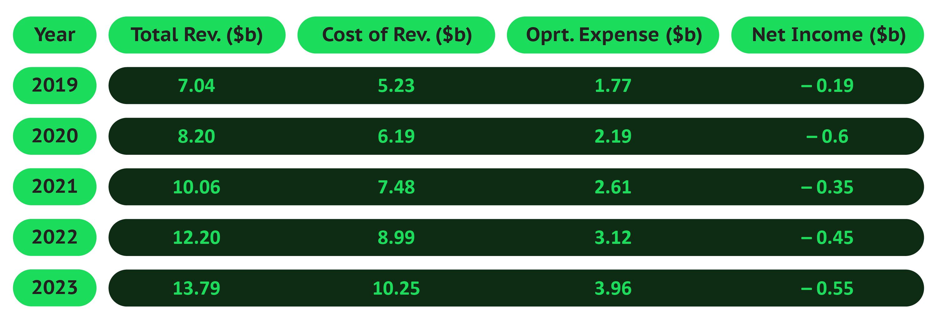
Financial Analysis

Slide 91
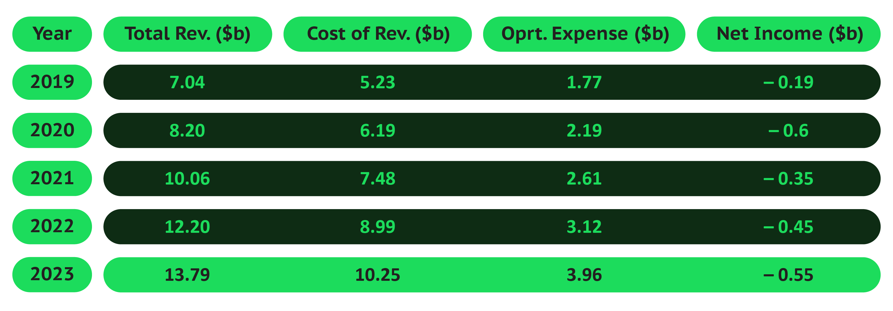
Financial Analysis
Revenue & Costs

Slide 92
Financial Analysis
Revenue & Costs

Slide 93
Revenue & Costs
13.79
$1.75b
12.20
10.06
10.25
8.99
8.20
7.48
7.04
6.19
5.23
$12.05b
2019
2020
2021
2022
2023
Premium Subscription Revenue
87% of total revenue
Total Revenue ($b)
Cost of Revenue ($b)
Ad-Supported Revenue
13% of total revenue

Slide 94
Revenue & Costs
13.79
74% of total revenue
12.20
10.06
10.25
8.99
8.20
7.48
7.04
6.19
5.23
2019
2020
2021
2022
2023
Total Revenue ($b)
Cost of Revenue ($b)

Slide 95
Revenue & Costs
13.79
74% of total revenue
12.20
10.06
10.25
8.99
Op. Expenses
8.20
7.48
7.04
6.19
$1.77b
R&D
5.23
$1.56b
Sales & Marketing
2019
2020
2021
2022
2023
Total Revenue ($b)
Cost of Revenue ($b)
$609m
G&A

Slide 96
Revenue & Costs
13.79
74% of total revenue
12.20
10.06
10.25
8.99
Op. Expenses
8.20
7.48
7.04
6.19
$1.77b
R&D
5.23
$1.56b
Sales & Marketing
2019
2020
2021
2022
2023
Total Revenue ($b)
Cost of Revenue ($b)
$609m
G&A

Slide 97
Revenue & Costs
13.79
74% of total revenue
12.20
10.06
10.25
8.99
Op. Expenses
8.20
7.48
7.04
6.19
$1.77b
R&D
5.23
$1.56b
Sales & Marketing
2019
2020
2021
2022
2023
Total Revenue ($b)
Cost of Revenue ($b)
$609m
G&A

Slide 98
Revenue & Costs
13.79
74% of total revenue
12.20
10.06
10.25
8.99
Op. Expenses
8.20
7.48
7.04
6.19
$1.77b
R&D
5.23
$1.56b
Sales & Marketing
2019
2020
2021
2022
2023
Total Revenue ($b)
Cost of Revenue ($b)
$609m
G&A
Projections
Revenue

Slide 99
Revenue & Costs
13.79
74% of total revenue
12.20
10.06
10.25
8.99
Op. Expenses
8.20
7.48
7.04
6.19
$1.77b
R&D
5.23
$1.56b
Sales & Marketing
2019
2020
2021
2022
2023
Total Revenue ($b)
Cost of Revenue ($b)
$609m
G&A
Projections
Revenue

Slide 100
Projections
Revenue
Total revenue
$15.96b
15% growth
Premium Revenue
Ad-Supported Revenue

Slide 101
Projections
Revenue
Total revenue
$15.96b
$13.96b
15% growth
Premium Revenue
Ad-Supported Revenue

Slide 102
Projections
Revenue
Total revenue
$15.96b
$13.96b
$1.98b
15% growth
Premium Revenue
Ad-Supported Revenue

Slide 103
Projections
Revenue
Total revenue
$15.96b
$13.96b
$1.98b
15% growth
Premium Revenue
Ad-Supported Revenue
Costs
Total costs

Slide 104
Projections
Revenue
Total revenue
$15.96b
$13.96b
$1.98b
15% growth
Premium Revenue
Ad-Supported Revenue
Costs
Total costs
$11.50b
Cost of revenue
R&D

Slide 105
Projections
Revenue
Total revenue
$15.96b
$13.96b
$1.98b
15% growth
Premium Revenue
Ad-Supported Revenue
Costs
Total costs
$11.50b
$1.98b
$1.67b
$1.98b
Cost of revenue
R&D

Slide 106
Projections
Revenue
Total revenue
$15.96b
$13.96b
$1.98b
15% growth
Premium Revenue
Ad-Supported Revenue
Costs
Total costs
$11.50b
$1.98b
$1.67b
Cost of revenue
R&D
S&M

Slide 107
Projections
Revenue
Total revenue
$15.96b
$13.96b
$1.98b
15% growth
Premium Revenue
Ad-Supported Revenue
Costs
Total costs
$625m
$11.50b
$1.98b
$1.67b
Cost of revenue
R&D
S&M
G&A

Slide 108
Projections
Revenue
Total revenue
$15.96b
$13.96b
$1.98b
15% growth
Premium Revenue
Ad-Supported Revenue
Costs
Total costs
$625m
$11.50b
$1.98b
$1.67b
$15.78b
Cost of revenue
R&D
S&M
G&A
Gross Margin: Expected to stabilize at 26-27%

Slide 109
Projections
Revenue
Total revenue
$15.96b
$13.96b
$1.98b
15% growth
Premium Revenue
Ad-Supported Revenue
Costs
Total costs
$625m
$11.50b
$1.98b
$1.67b
$15.78b
Cost of revenue
R&D
S&M
G&A
Gross Margin: Expected to stabilize at 26-27%

Slide 110


Projections
Revenue
Total revenue
$15.96b
$13.96b
$1.98b
15% growth
Premium Revenue
Ad-Supported Revenue
Costs
Total costs
$625m
$11.50b
$1.98b
$1.67b
$15.78b
Cost of revenue
R&D
S&M
G&A
Gross Margin: Expected to stabilize at 26-27%
Strengths
Premium Subscription Growth
236 million subscribers in 2023 (+15% YOY growth
Primary revenue driver, generating $12.05 billion
Content Discoverability & Personalization
Exclusive podcast investments contribute to retention and differentiation
Operational Efficiency
Gross profit increased to $3.53 billion in 2023, reflecting better cost control

Slide 111
Projections
Revenue
Total revenue
$15.96b
$13.96b
$1.98b
15% growth
Premium Revenue
Ad-Supported Revenue
Costs
Total costs
$625m
$11.50b
$1.98b
$1.67b
$15.78b
Cost of revenue
R&D
S&M
G&A
Gross Margin: Expected to stabilize at 26-27%
Strengths
Premium Subscription Growth
236 million subscribers in 2023 (+15% YOY growth
Primary revenue driver, generating $12.05 billion
Content Discoverability & Personalization
Exclusive podcast investments contribute to retention and differentiation
Operational Efficiency
Gross profit increased to $3.53 billion in 2023, reflecting better cost control

Slide 112
Strengths
Premium Subscription Growth
236 million subscribers in 2023 (+15% YOY growth
Primary revenue driver, generating $12.05 billion
Content Discoverability & Personalization
Exclusive podcast investments contribute to retention and differentiation
Operational Efficiency
Gross profit increased to $3.53 billion in 2023, reflecting better cost control

Slide 113
Strengths
Premium Subscription Growth
236 million subscribers in 2023 (+15% YOY growth
Primary revenue driver, generating $12.05 billion
Content Discoverability & Personalization
Exclusive podcast investments contribute to retention and differentiation
Operational Efficiency
Gross profit increased to $3.53 billion in 2023, reflecting better cost control

Slide 114
Strengths
Premium Subscription Growth
236 million subscribers in 2023 (+15% YOY growth
Primary revenue driver, generating $12.05 billion
Content Discoverability & Personalization
Exclusive podcast investments contribute to retention and differentiation
Operational Efficiency
Gross profit increased to $3.53 billion in 2023, reflecting better cost control

Slide 115
Strengths
Premium Subscription Growth
236 million subscribers in 2023 (+15% YOY growth
Primary revenue driver, generating $12.05 billion
Content Discoverability & Personalization
Exclusive podcast investments contribute to retention and differentiation
Operational Efficiency
Gross profit increased to $3.53 billion in 2023, reflecting better cost control

Slide 116

Strengths
Premium Subscription Growth
236 million subscribers in 2023 (+15% YOY growth
Primary revenue driver, generating $12.05 billion
Content Discoverability & Personalization
Exclusive podcast investments contribute to retention and differentiation
Operational Efficiency
Gross profit increased to $3.53 billion in 2023, reflecting better cost control
Areas for Improvement
Ad-Supported Revenue Growth
Ad revenue growth is slower compared to Premium; strategies to optimize ad placements are needed
Cost Management in Content Licensing
High costs impact profitability; strategies needed to maximize returns on content investments
Subscriber Churn
Managing churn remains critical; personalization and social features can play a key role in retention

Slide 117
Strengths
Premium Subscription Growth
236 million subscribers in 2023 (+15% YOY growth
Primary revenue driver, generating $12.05 billion
Content Discoverability & Personalization
Exclusive podcast investments contribute to retention and differentiation
Operational Efficiency
Gross profit increased to $3.53 billion in 2023, reflecting better cost control
Areas for Improvement
Ad-Supported Revenue Growth
Ad revenue growth is slower compared to Premium; strategies to optimize ad placements are needed
Cost Management in Content Licensing
High costs impact profitability; strategies needed to maximize returns on content investments
Subscriber Churn
Managing churn remains critical; personalization and social features can play a key role in retention

Slide 118
Areas for Improvement
Ad-Supported Revenue Growth
Ad revenue growth is slower compared to Premium; strategies to optimize ad placements are needed
Cost Management in Content Licensing
High costs impact profitability; strategies needed to maximize returns on content investments
Subscriber Churn
Managing churn remains critical; personalization and social features can play a key role in retention

Slide 119
Areas for Improvement
Ad-Supported Revenue Growth
Ad revenue growth is slower compared to Premium; strategies to optimize ad placements are needed
Cost Management in Content Licensing
High costs impact profitability; strategies needed to maximize returns on content investments
Subscriber Churn
Managing churn remains critical; personalization and social features can play a key role in retention

Slide 120
Areas for Improvement
Ad-Supported Revenue Growth
Ad revenue growth is slower compared to Premium; strategies to optimize ad placements are needed
Cost Management in Content Licensing
High costs impact profitability; strategies needed to maximize returns on content investments
Subscriber Churn
Managing churn remains critical; personalization and social features can play a key role in retention

Slide 121

Areas for Improvement
Ad-Supported Revenue Growth
Ad revenue growth is slower compared to Premium; strategies to optimize ad placements are needed
Cost Management in Content Licensing
High costs impact profitability; strategies needed to maximize returns on content investments
Subscriber Churn
Managing churn remains critical; personalization and social features can play a key role in retention
Key Performance Indicators (KPIs)
Monthly Active Users (MAUs)
Premium Subscribers
Churn Rate
Average Revenue per User (ARPU)

Slide 122

Areas for Improvement
Ad-Supported Revenue Growth
Ad revenue growth is slower compared to Premium; strategies to optimize ad placements are needed
Cost Management in Content Licensing
High costs impact profitability; strategies needed to maximize returns on content investments
Subscriber Churn
Managing churn remains critical; personalization and social features can play a key role in retention
Key Performance Indicators (KPIs)
Monthly Active Users (MAUs)
Premium Subscribers
Churn Rate
Average Revenue per User (ARPU)
User behavior

Slide 123
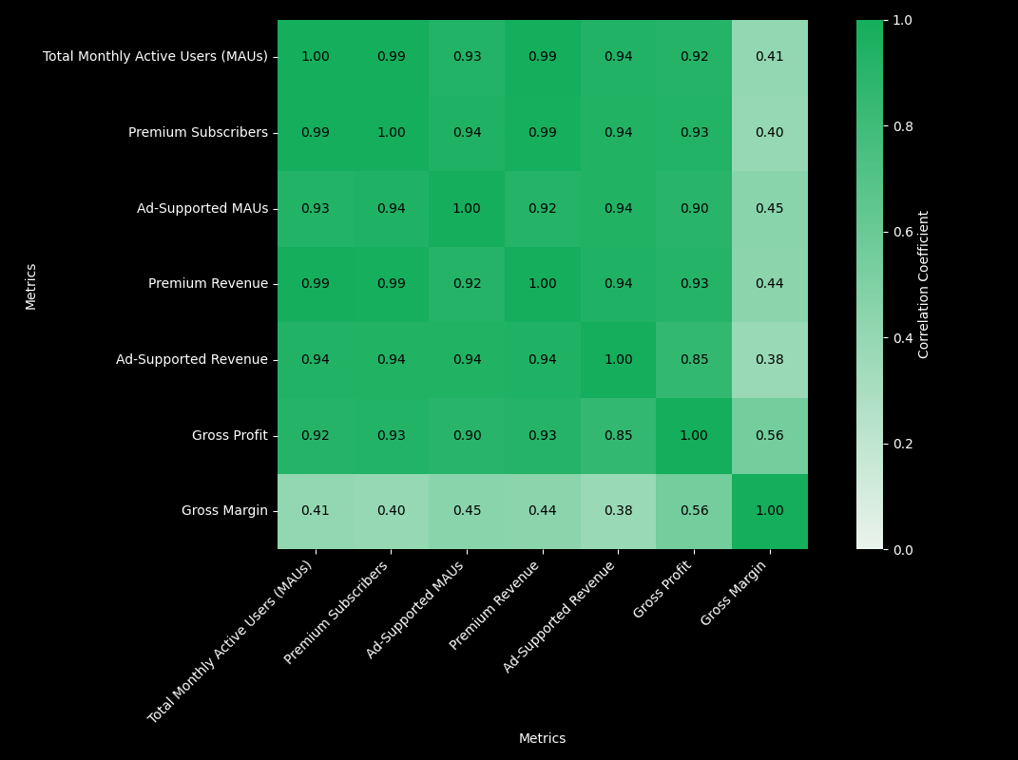
Key Performance Indicators (KPIs)
Monthly Active Users (MAUs)
Premium Subscribers
Churn Rate
Average Revenue per User (ARPU)
User behavior
Correlation Matrix
Gross Profit shows strong positive correlations with both Premium Revenue and Total MAUs, suggesting that user growth translates effectively into profitability

Slide 124
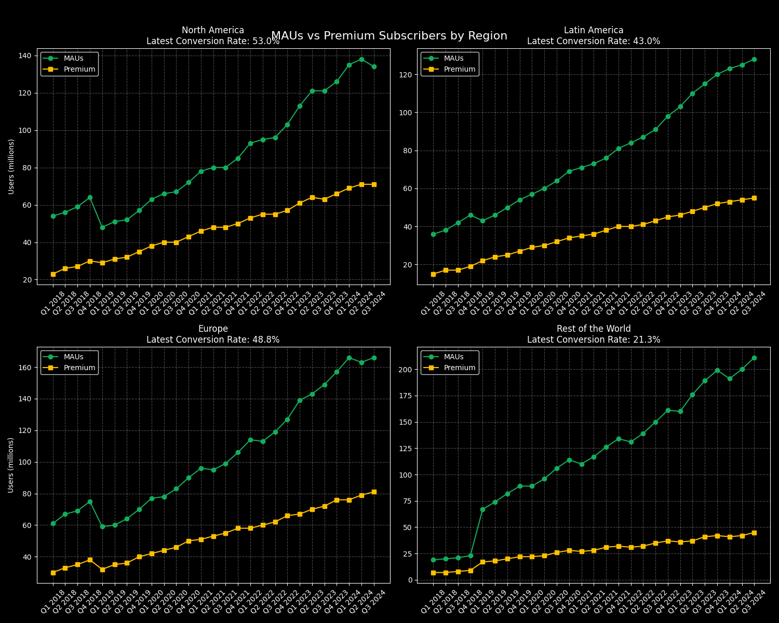
User behavior
Correlation Matrix
MAUs vs Premium by Region
Gross Profit shows strong positive correlations with both Premium Revenue and Total MAUs, suggesting that user growth translates effectively into profitability
MAUs
Premium

Slide 125
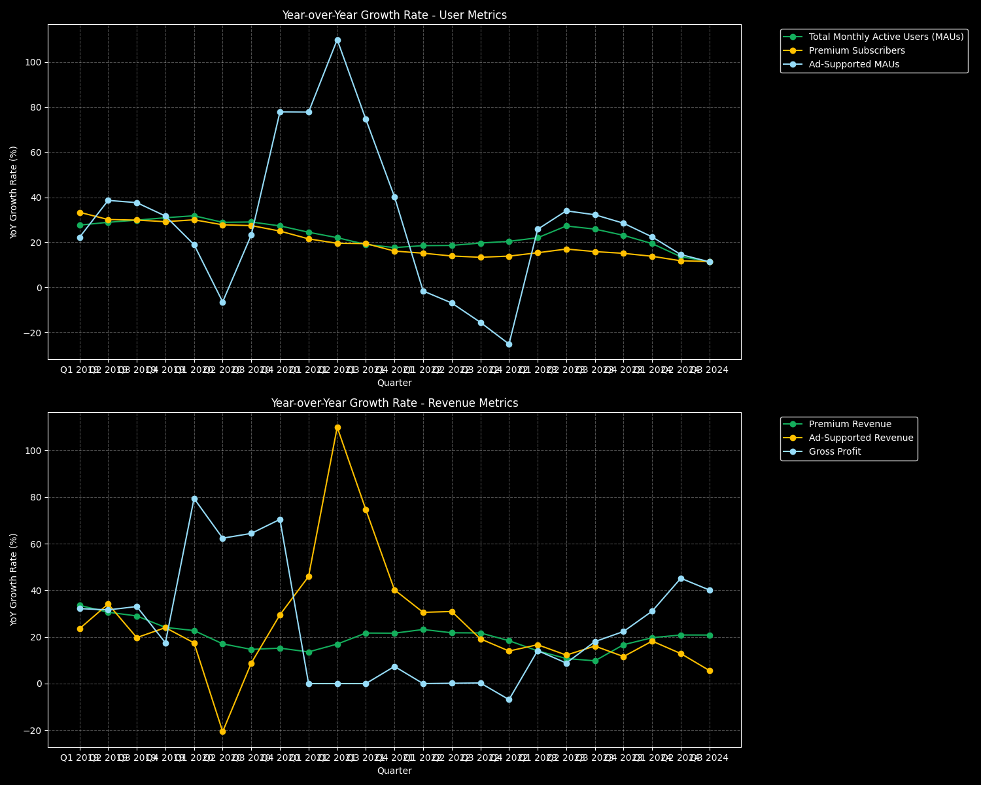
Correlation Matrix
MAUs vs Premium by Region
YoY Growth Rate — User Metrics
Gross Profit shows strong positive correlations with both Premium Revenue and Total MAUs, suggesting that user growth translates effectively into profitability
MAUs
Premium
Total Monthly Active Users (MAUs)
Premium Subscribers
Add-supported MAUs

Slide 126
MAUs vs Premium by Region
YoY Growth Rate — User Metrics
YoY Growth Rate — Revenue Metrics
MAUs
Premium
Total Monthly Active Users (MAUs)
Premium Subscribers
Add-supported MAUs
Premium Revenue
Add-supported Revenue
Gross Profit

Slide 127
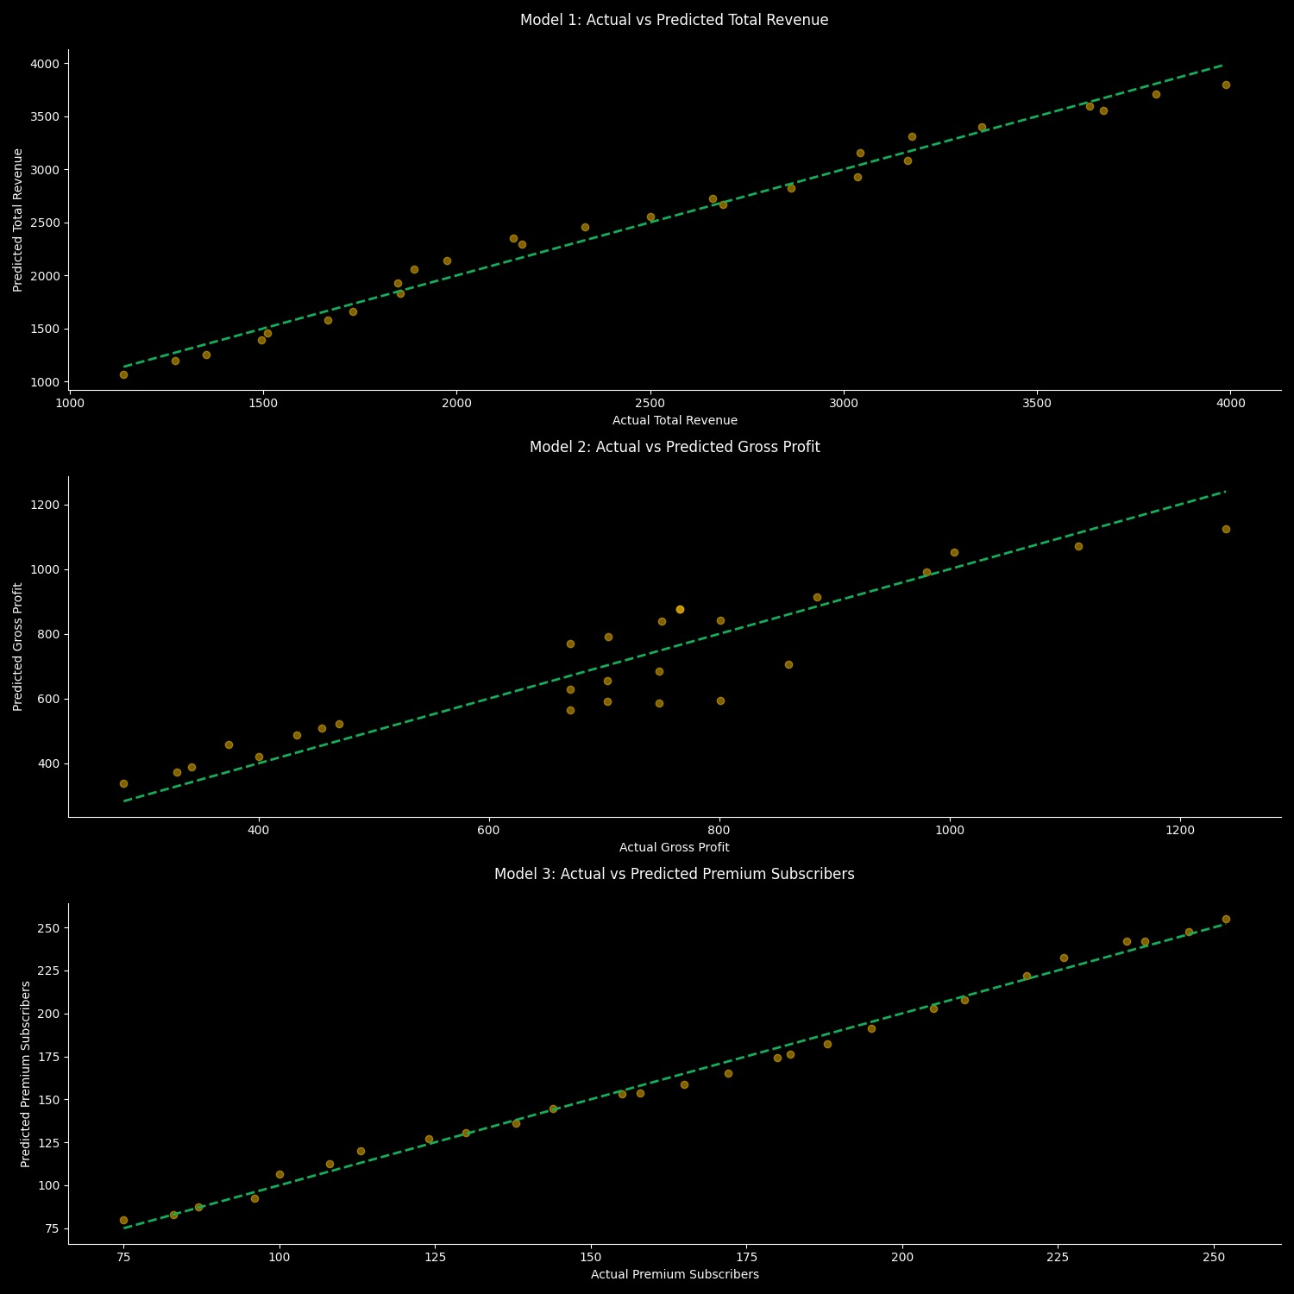
YoY Growth Rate — User Metrics
YoY Growth Rate — Revenue Metrics
Model 1
The model predicts total revenue using Premium Subscribers and Ad-Supported MAUs Premium Subscribers
Total Monthly Active Users (MAUs)
Premium Subscribers
Add-supported MAUs
Premium Revenue
Add-supported Revenue
Gross Profit

Slide 128
YoY Growth Rate — Revenue Metrics
Model 1
The model predicts total revenue using Premium Subscribers and Ad-Supported MAUs Premium Subscribers
Premium Revenue
Add-supported Revenue
Gross Profit

Slide 129
Model 2
The model predicts gross profit using Premium Revenue and Ad-Supported Revenue

Slide 130
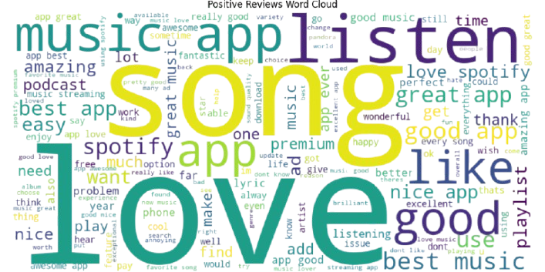
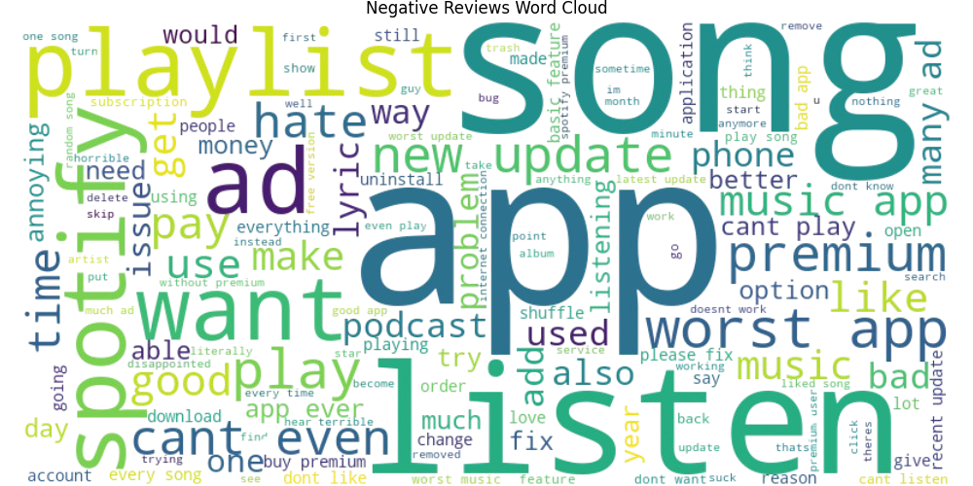
Model 3
Text analysis — word cloud
Over 3.4M Reviews were scraped, of which 1.4M recent reviews between 2021-2024 were selected, first we classified positive and negative reviews and plotted word clouds for the same
The model predicts Premium Subscribers using regional MAU numbers

Slide 131
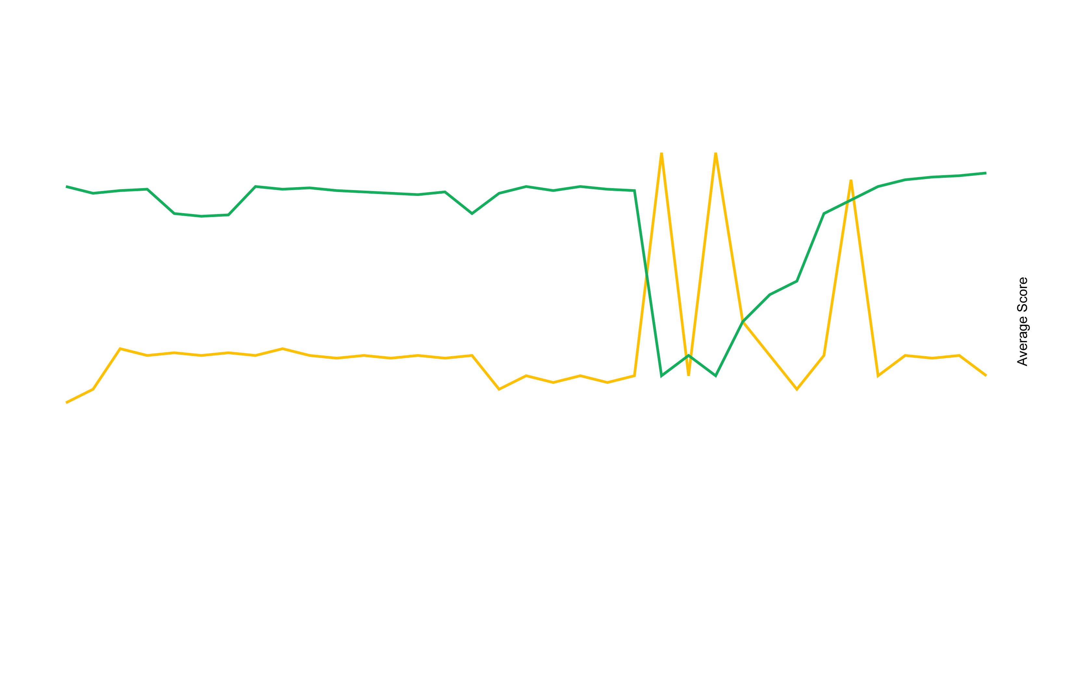
Model 3
Text analysis — word cloud
Reviews Counts vs. Avg. Scores
Over 3.4M Reviews were scraped, of which 1.4M recent reviews between 2021-2024 were selected, first we classified positive and negative reviews and plotted word clouds for the same
The model predicts Premium Subscribers using regional MAU numbers
Avg. Score
Reviews Count

Slide 132

Text analysis — word cloud
Reviews Counts vs. Avg. Scores
Scores of premium-related reviews
Over 3.4M Reviews were scraped, of which 1.4M recent reviews between 2021-2024 were selected, first we classified positive and negative reviews and plotted word clouds for the same
Avg. Score
Reviews Count

Slide 133

Reviews Counts vs. Avg. Scores
Scores of premium-related reviews
Avg. Score
Reviews Count
Recommendations
Premium Subscription & Regional MAU’s Growth Strategy
Premium conversion efforts developing targeted premium features for ad-supported users
region-specific pricing strategies for emerging markets (Rest of World)
Create localized content, playlists feature local artists
Expand family and student plan offerings
Ad Revenue Enhancement
build long-term advertiser relationships
Implement advanced ad targeting to improve ad effectiveness
special ad packages for peak seasons
Cost & Content Management
original content including podcasts, music, and shows exclusive content library reduce dependency
New Revenue Streams i.e. Podcasts
enhancing ad technology with dynamic insertion and programmatic ad capabilities

Slide 134
Scores of premium-related reviews
Recommendations
Premium Subscription & Regional MAU’s Growth Strategy
Premium conversion efforts developing targeted premium features for ad-supported users
region-specific pricing strategies for emerging markets (Rest of World)
Create localized content, playlists feature local artists
Expand family and student plan offerings
Ad Revenue Enhancement
build long-term advertiser relationships
Implement advanced ad targeting to improve ad effectiveness
special ad packages for peak seasons
Cost & Content Management
original content including podcasts, music, and shows exclusive content library reduce dependency
New Revenue Streams i.e. Podcasts
enhancing ad technology with dynamic insertion and programmatic ad capabilities

Slide 135
Speak Up!

Slide 136
Areas for Improvement
Metrics from annual financial
statement 20-F
Ad-Supported Revenue Growth
Ad revenue growth is slower compared to Premium; strategies to optimize ad placements are needed
Cost Management in Content Licensing
High costs impact profitability; strategies needed to maximize returns on content investments
Subscriber Churn
Managing churn remains critical; personalization and social features can play a key role in retention
Monthly Active Users (MAUs):
602 million
Premium Subscribers
Churn Rate
Average Revenue Per User (ARPU)
Podcast & Non-Music Content Revenue
Cost of Revenue

Slide 137
Areas for Improvement
Metrics from annual financial
statement 20-F
Monthly Active Users (MAUs):
Ad-Supported Revenue Growth
Ad revenue growth is slower compared to Premium; strategies to optimize ad placements are needed
Cost Management in Content Licensing
High costs impact profitability; strategies needed to maximize returns on content investments
Subscriber Churn
Managing churn remains critical; personalization and social features can play a key role in retention
Premium Subscribers
236 million
Churn Rate
Average Revenue Per User (ARPU)
Podcast & Non-Music Content Revenue
Cost of Revenue

Slide 138
Metrics from annual financial
statement 20-F
Monthly Active Users (MAUs):
Premium Subscribers
Not disclosed
Churn Rate
(Target for reduction: 1-2%)
Average Revenue Per User (ARPU)
Podcast & Non-Music Content Revenue
Cost of Revenue

Slide 139
Metrics from annual financial
statement 20-F
Premium Subscribers
Churn Rate
$4.58
Average Revenue Per User (ARPU)
(converted from €4.39)
Podcast & Non-Music Content Revenue
Cost of Revenue

Slide 140
Metrics from annual financial
statement 20-F
Churn Rate
Average Revenue Per User (ARPU)
$2.08 billion
Podcast & Non-Music Content Revenue
(converted from €2 billion)
Cost of Revenue

Slide 141
Metrics from annual financial
statement 20-F
Average Revenue Per User (ARPU)
Podcast & Non-Music Content Revenue
$10.25 billion
Cost of Revenue
(converted from €9.85 billion)
Key Performance Indicators (KPIs)
Monthly Active Users (MAUs)
Premium Subscribers
Churn Rate
Average Revenue per User (ARPU

Slide 142

KPI — ARPU (Avg. Revenue Per User)
Peak Listening Time Engagement by Age Group
Measure the distribution of active users across different age groups during specific time slots (morning, afternoon, night).
Focus on understanding when users are most engaged based on age demographics
How It Supports Recommendations?
Identify when different age groups are most likely to be active, allowing Spotify to target time-specific premium promotions (e.g., morning promotions for 35–60 age group, evening promotions for 12–20).

Slide 143
KPI — ARPU (Avg. Revenue Per User)
Peak Listening Time Engagement by Age Group
Measure the distribution of active users across different age groups during specific time slots (morning, afternoon, night).
Focus on understanding when users are most engaged based on age demographics
How It Supports Recommendations?
Identify when different age groups are most likely to be active, allowing Spotify to target time-specific premium promotions (e.g., morning promotions for 35–60 age group, evening promotions for 12–20).

Slide 144
KPI — ARPU (Avg. Revenue Per User)
Peak Listening Time Engagement by Age Group
Measure the distribution of active users across different age groups during specific time slots (morning, afternoon, night).
Focus on understanding when users are most engaged based on age demographics
How It Supports Recommendations?
Identify when different age groups are most likely to be active, allowing Spotify to target time-specific premium promotions (e.g., morning promotions for 35–60 age group, evening promotions for 12–20).

Slide 145
KPI — ARPU (Avg. Revenue Per User)
Peak Listening Time Engagement by Age Group
Measure the distribution of active users across different age groups during specific time slots (morning, afternoon, night).
Focus on understanding when users are most engaged based on age demographics
How It Supports Recommendations?
Identify when different age groups are most likely to be active, allowing Spotify to target time-specific premium promotions (e.g., morning promotions for 35–60 age group, evening promotions for 12–20).

Slide 146
KPI — ARPU (Avg. Revenue Per User)
Peak Listening Time Engagement by Age Group
Measure the distribution of active users across different age groups during specific time slots (morning, afternoon, night).
Focus on understanding when users are most engaged based on age demographics
How It Supports Recommendations?
Identify when different age groups are most likely to be active, allowing Spotify to target time-specific premium promotions (e.g., morning promotions for 35–60 age group, evening promotions for 12–20).

Slide 147
KPI — ARPU (Avg. Revenue Per User)
Peak Listening Time Engagement by Age Group
Measure the distribution of active users across different age groups during specific time slots (morning, afternoon, night).
Focus on understanding when users are most engaged based on age demographics
How It Supports Recommendations?
Identify when different age groups are most likely to be active, allowing Spotify to target time-specific premium promotions (e.g., morning promotions for 35–60 age group, evening promotions for 12–20).

Slide 148
Hello!

Slide 149
Hello!

Slide 151
Hello!

Slide 152
Metrics from annual financial
statement 20-F
Average Revenue Per User (ARPU)
Podcast & Non-Music Content Revenue
$10.25 billion
Cost of Revenue
(converted from €9.85 billion)
KPI — Premium Subscriber Growth
Premium vs. Non-Premium User Distribution
Competitive Highlights

Slide 153

KPI — Premium Subscriber Growth
Premium vs. Non-Premium User Distribution
Competitive Highlights
65%
Free (Ad-
Supported)

Slide 154

KPI — Premium Subscriber Growth
Premium vs. Non-Premium User Distribution
Competitive Highlights
35%
Premium
65%
Free (Ad-
Supported)

Slide 155
KPI — Premium Subscriber Growth
Premium vs. Non-Premium User Distribution
Competitive Highlights
Recommendation
Highlighting exclusive perks (such as an ad-free experience, high-quality audio, or offline downloads) should be the focus of premium subscription marketing if they want to improve
Use time-slot data to determine peak listening hours and then allocate dollars to targeted digital marketing efforts. This will bring in free-tier users
35%
Premium
65%
Free (Ad-
Supported)

Slide 156
KPI — Premium Subscriber Growth
Premium vs. Non-Premium User Distribution
Competitive Highlights
Recommendation
Highlighting exclusive perks (such as an ad-free experience, high-quality audio, or offline downloads) should be the focus of premium subscription marketing if they want to improve
Use time-slot data to determine peak listening hours and then allocate dollars to targeted digital marketing efforts. This will bring in free-tier users
35%
Premium
65%
Free (Ad-
Supported)

Slide 157
KPI — Premium Subscriber Growth
Premium vs. Non-Premium User Distribution
Competitive Highlights
By age group
By gender
Recommendation
Highlighting exclusive perks (such as an ad-free experience, high-quality audio, or offline downloads) should be the focus of premium subscription marketing if they want to improve
Use time-slot data to determine peak listening hours and then allocate dollars to targeted digital marketing efforts. This will bring in free-tier users
35%
83%
78%
Premium
70%
67%
55%
45%
65%
30%
33%
Free (Ad-
Supported)
18%
22%
20-35
35-60
Female
Male
Other
Total Revenue ($b)
Cost of Revenue ($b)

Slide 158
KPI — Premium Subscriber Growth
Premium vs. Non-Premium User Distribution
Competitive Highlights
By age group
By gender
Recommendation
Highlighting exclusive perks (such as an ad-free experience, high-quality audio, or offline downloads) should be the focus of premium subscription marketing if they want to improve
Use time-slot data to determine peak listening hours and then allocate dollars to targeted digital marketing efforts. This will bring in free-tier users
35%
83%
78%
Premium
70%
67%
55%
45%
65%
30%
33%
Free (Ad-
Supported)
18%
22%
20-35
35-60
Female
Male
Other
Total Revenue ($b)
Cost of Revenue ($b)

Slide 159
KPI — Premium Subscriber Growth
Premium vs. Non-Premium User Distribution
By age group
By gender
83%
78%
70%
67%
55%
45%
30%
33%
18%
22%
20-35
35-60
Female
Male
Other
Total Revenue ($b)
Cost of Revenue ($b)

Slide 160
KPI — Premium Subscriber Growth
Premium vs. Non-Premium User Distribution
By age group
By gender
Recommendation
Target users between the ages of 20 and 35 with a focus on family plans, student discounts, and playlist sharing to boost conversions
Divert funds towards gamified campaigns or loyalty rewards that appeal to younger users
83%
78%
70%
67%
55%
45%
30%
33%
18%
22%
20-35
35-60
Female
Male
Other
Total Revenue ($b)
Cost of Revenue ($b)

Slide 161
KPI — Premium Subscriber Growth
Premium vs. Non-Premium User Distribution
By age group
By gender
Recommendation
Target users between the ages of 20 and 35 with a focus on family plans, student discounts, and playlist sharing to boost conversions
Divert funds towards gamified campaigns or loyalty rewards that appeal to younger users
83%
78%
70%
67%
55%
45%
30%
33%
18%
22%
20-35
35-60
Female
Male
Other
Total Revenue ($b)
Cost of Revenue ($b)

Slide 162
KPI — Premium Subscriber Growth
KPI — ARPU (Avg. Revenue Per User)
Premium vs. Non-Premium User Distribution
Peak Listening Time Engagement by Age Group
By age group
By gender
Recommendation
Target users between the ages of 20 and 35 with a focus on family plans, student discounts, and playlist sharing to boost conversions
Divert funds towards gamified campaigns or loyalty rewards that appeal to younger users
83%
Measure the distribution of active users across different age groups during specific time slots (morning, afternoon, night).
Focus on understanding when users are most engaged based on age demographics
How It Supports Recommendations?
Identify when different age groups are most likely to be active, allowing Spotify to target time-specific premium promotions (e.g., morning promotions for 35–60 age group, evening promotions for 12–20).
78%
70%
67%
55%
45%
30%
33%
18%
22%
20-35
35-60
Female
Male
Other
Total Revenue ($b)
Cost of Revenue ($b)

Slide 163
KPI — Premium Subscriber Growth
KPI — ARPU (Avg. Revenue Per User)
Premium vs. Non-Premium User Distribution
Peak Listening Time Engagement by Age Group
By age group
By gender
Recommendation
Target users between the ages of 20 and 35 with a focus on family plans, student discounts, and playlist sharing to boost conversions
Divert funds towards gamified campaigns or loyalty rewards that appeal to younger users
83%
Measure the distribution of active users across different age groups during specific time slots (morning, afternoon, night).
Focus on understanding when users are most engaged based on age demographics
How It Supports Recommendations?
Identify when different age groups are most likely to be active, allowing Spotify to target time-specific premium promotions (e.g., morning promotions for 35–60 age group, evening promotions for 12–20).
78%
70%
67%
55%
45%
30%
33%
18%
22%
20-35
35-60
Female
Male
Other
Total Revenue ($b)
Cost of Revenue ($b)

Slide 164
KPI — Premium Subscriber Growth
Premium vs. Non-Premium User Distribution
Competitive Highlights
By age group
Recommendation
Highlighting exclusive perks (such as an ad-free experience, high-quality audio, or offline downloads) should be the focus of premium subscription marketing if they want to improve
Use time-slot data to determine peak listening hours and then allocate dollars to targeted digital marketing efforts. This will bring in free-tier users
35%
83%
78%
Premium
70%
67%
55%
45%
65%
30%
33%
Free (Ad-
Supported)
18%
22%
2019
2020
2019
2020
2020
2019
Total Revenue ($b)
Cost of Revenue ($b)

Slide 165
Metrics from annual financial
statement 20-F
New Hires
Monthly Active Users (MAUs):
Monthly Active Users (MAUs):
602 million
High Potentials
Engaged Dreamers
Disengaged Stars
Misaligned Stars

Slide 166
Strengths
Premium Subscription Growth
236 million subscribers in 2023 (+15% YOY growth
Primary revenue driver, generating $12.05 billion
Content Discoverability & Personalization
Exclusive podcast investments contribute to retention and differentiation
Operational Efficiency
Gross profit increased to $3.53 billion in 2023, reflecting better cost control

Slide 167
Revenue & Costs
13.79
74% of total revenue
12.20
10.06
10.25
8.99
Op. Expenses
8.20
7.48
7.04
6.19
$1.77b
R&D
5.23
$1.56b
Sales & Marketing
2019
2020
2021
2022
2023
Total Revenue ($b)
Cost of Revenue ($b)
$609m
G&A
Projections
Revenue
Total revenue
$15.96b
$13.96b
$1.98b
15% growth
Premium Revenue
Ad-Supported Revenue
Costs
Total costs
$625m
$11.50b
$1.98b
$1.67b
$15.78b
Cost of revenue
R&D
S&M
G&A
Gross Margin: Expected to stabilize at 26-27%

Slide 168
Revenue & Costs
13.79
74% of total revenue
12.20
10.06
10.25
8.99
Op. Expenses
8.20
7.48
7.04
6.19
$1.77b
R&D
5.23
$1.56b
Sales & Marketing
2019
2020
2021
2022
2023
Total Revenue ($b)
Cost of Revenue ($b)
$609m
G&A
Projections
Revenue
Total revenue
$15.96b
$13.96b
$1.98b
15% growth
Premium Revenue
Ad-Supported Revenue
Costs
Total costs
$49.6b
$49.6b
$49.6b
$49.6b
$15.96b
Cost of revenue
R&D
S&M
G&A
Gross Margin: Expected to stabilize at 26-27%

Slide 169
Revenue & Costs
13.79
74% of total revenue
12.20
10.06
10.25
8.99
Op. Expenses
8.20
7.48
7.04
6.19
$1.77b
R&D
5.23
$1.56b
Sales & Marketing
2019
2020
2021
2022
2023
Total Revenue ($b)
Cost of Revenue ($b)
$609m
G&A
Projections
Revenue
Global revenue
2023
2024
$30.23B
$33.97B
13.1% CAGR
Costs
Projected revenue
2028
$49.6B
19.09% CAGR

Slide 170
Our team
Rudaina A. Mitman
Ali Alansari
Saif Alneyadi
Ruthvik Vijayakumar
Sanjay Devang
MBA/MS Information Systems Technology
MS Information Systems Technology
MS Information Systems Technology
MS Information Systems Technology
MS Information Systems Technology
Industry of expertise:
Consulting, Finance, FinTech, Media, International Org.
Industry of expertise:
Consulting, Finance, FinTech, Media, International Org.
Industry of expertise:
Consulting, Finance, FinTech, Media, International Org.
Industry of expertise:
Consulting, Finance, FinTech, Media, International Org.
Industry of expertise:
Consulting, Finance, FinTech, Media, International Org.
Agenda
Company
overview
+ Introduction
+ Business model
+ User demographics
Analyses
+ Methodology of
conducting analyses
+ Data source
+ Market analysis
+ Financial analysis
+ Metrics from annual
financial analysis
Key Performance
Indicators (KPIs)

Slide 171
Our team
Hello!
Rudaina A. Mitman
Ali Alansari
Saif Alneyadi
Ruthvik Vijayakumar
Sanjay Devang
MBA/MS Information Systems Technology
MS Information Systems Technology
MS Information Systems Technology
MS Information Systems Technology
MS Information Systems Technology
Industry of expertise:
Consulting, Finance, FinTech, Media, International Org.
Industry of expertise:
Consulting, Finance, FinTech, Media, International Org.
Industry of expertise:
Consulting, Finance, FinTech, Media, International Org.
Industry of expertise:
Consulting, Finance, FinTech, Media, International Org.
Industry of expertise:
Consulting, Finance, FinTech, Media, International Org.
Agenda
Company
overview
+ Introduction
+ Business model
+ User demographics
Analyses
+ Methodology of
conducting analyses
+ Data source
+ Market analysis
+ Financial analysis
+ Metrics from annual
financial analysis
Key Performance
Indicators (KPIs)

Slide 172
Hello!
Agenda
Company
overview
+ Introduction
+ Business model
+ User demographics
Analyses
+ Methodology of
conducting analyses
+ Data source
+ Market analysis
+ Financial analysis
+ Metrics from annual
financial analysis
Key Performance
Indicators (KPIs)

Slide 173
Hello!
Agenda
Company
overview
+ Introduction
+ Business model
+ User demographics
Analyses
+ Methodology of
conducting analyses
+ Data source
+ Market analysis
+ Financial analysis
+ Metrics from annual
financial analysis
Key Performance
Indicators (KPIs)
Recommendations

Slide 174
Hello!
Agenda
Company
overview
+ Introduction
+ Business model
+ User demographics
Analyses
+ Methodology of
conducting analyses
+ Data source
+ Market analysis
+ Financial analysis
+ Metrics from annual
financial analysis
Key Performance
Indicators (KPIs)
Recommendations

Slide 175
Hello!
Agenda
Company
overview
+ Introduction
+ Business model
+ User demographics
Analyses
+ Methodology of
conducting analyses
+ Data source
+ Market analysis
+ Financial analysis
+ Metrics from annual
financial analysis
Key Performance
Indicators (KPIs)
Recommendations

Slide 176

Company Overview
2024
640m monthly active users
180+ markets worldwide
100m+
tracks
6m+
Podcast titles
IND.
EST.
HQ
Music Streaming
Podcasting
Audio Entertainment
2006
by Daniel Ek and Martin Lorentzon
Stockholm, Sweden
Business Model
Freemium
business model
Entry-level access
provided in the free tier, supported by advertisements
Premium tier
offers ad-free listening, offline playback, and higher audio quality
Subscription plans for Individuals, Students, and Families
640 million
active users, from which
252 million
are paying subscribers
Royalty payments
for creators based on the number of streams
Spotify for Artists
offers promotional tools like data analytics

Slide 177
Company Overview
2024
640m monthly active users
180+ markets worldwide
100m+
tracks
6m+
Podcast titles
IND.
EST.
HQ
Music Streaming
Podcasting
Audio Entertainment
2006
by Daniel Ek and Martin Lorentzon
Stockholm, Sweden
Business Model
Freemium
business model
Entry-level access
provided in the free tier, supported by advertisements
Premium tier
offers ad-free listening, offline playback, and higher audio quality
Subscription plans for Individuals, Students, and Families
640 million
active users, from which
252 million
are paying subscribers
Royalty payments
for creators based on the number of streams
Spotify for Artists
offers promotional tools like data analytics

Slide 178
Hey there!
Our team
Rudaina A. Mitman
Ali Alansari
Saif Alneyadi
Ruthvik Vijayakumar
Sanjay Devang
MBA/MS Information Systems Technology
MS Information Systems Technology, Entrepreneurship
MS Information Systems Technology
MS Information Systems Technology
MS Information Systems Technology
Area of expertise:
Consulting, Finance, FinTech, Media, International Org.
Area of expertise:
Technology, Entrepreneurship, SMEs
Area of expertise:
Technology, Computer Engineering
Area of expertise:
Technology, AdTech
Area of expertise:
Technology, Cloud Solution Architecture
Agenda
Company
overview
+ Introduction
+ Business model
+ User demographics
Analyses
+ Methodology of
conducting analyses
+ Data source
+ Market analysis
+ Financial analysis
+ Metrics from annual
financial analysis
Key Performance
Indicators (KPIs)

Slide 179
Market Analysis
Competitive Highlights
Streaming services account for
79.5%
of U.S. music revenues (2019)
Competitive Advantages
& Product Differentiation
Brand Loyalty and Trust
Features like Spotify Wrapped, Hi-Fi Music foster user loyalty and trust, driving a CAGR of 27.89% in the user base from 2015 to 2023
Data-driven Personalization
Proprietary AI and data analytics curate highly personalized content (e.g., Discover Weekly and Release Radar), boosting engagement and retention
Artist Relationships
Hosts over 11 million artists with tools for profile management, audience insights, and content promotion. With competitive payouts ($0.003–$0.005 per stream)
Product Differentiation
Personalization: Highly personalized listening experience
Exclusive Content: The Joe Rogan Experience & Taylor swift
Power tools for the Artists Platform: Campaign Kit, Marquee, Discovery Mode, and Showcase

